Slide 1


Baswa Hotel Network System
This presentation outlines the design of a comprehensive hotel network system simulation, covering key technologies like VLANs, DHCP, and WLAN. We'll explore how these technologies work together to provide secure and efficient network connectivity within a hotel environment.

Slide 2
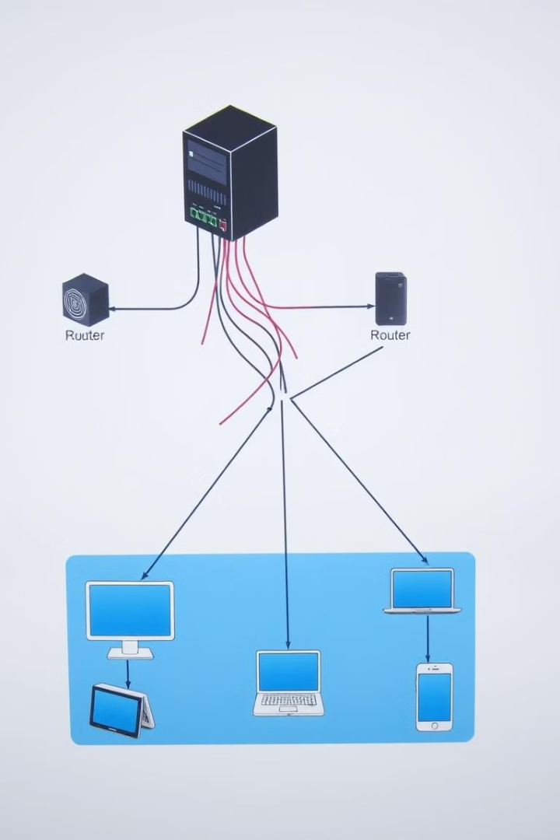
Overview of Network Technologies Implemented
1
VLANs
2
Inter-VLAN Routing
VLANs segment the network into smaller, logical groups. This enhances security by isolating traffic and improving performance.
Inter-VLAN routing allows communication between different VLANs. This is essential for guest access to the internet and other services.
3
DHCP
4
Port Security
DHCP automatically assigns IP addresses to devices. This streamlines network management and simplifies device configuration.
Port security limits access to network ports, enhancing security by preventing unauthorized device connection.

Slide 3
VLAN Configuration and Inter-VLAN Routing
VLAN Configuration
Inter-VLAN Routing
Router on a Stick
VLANs are configured on switches to logically separate network traffic. This enables the creation of distinct broadcast domains, enhancing security and network performance.
Inter-VLAN routing uses a router to connect different VLANs. This allows devices on separate VLANs to communicate, enabling essential services like guest access and administrative communication.
The "Router on a Stick" configuration uses sub-interfaces on the router to handle traffic between VLANs. This is a cost-effective and flexible solution for routing traffic between VLANs.

Slide 4
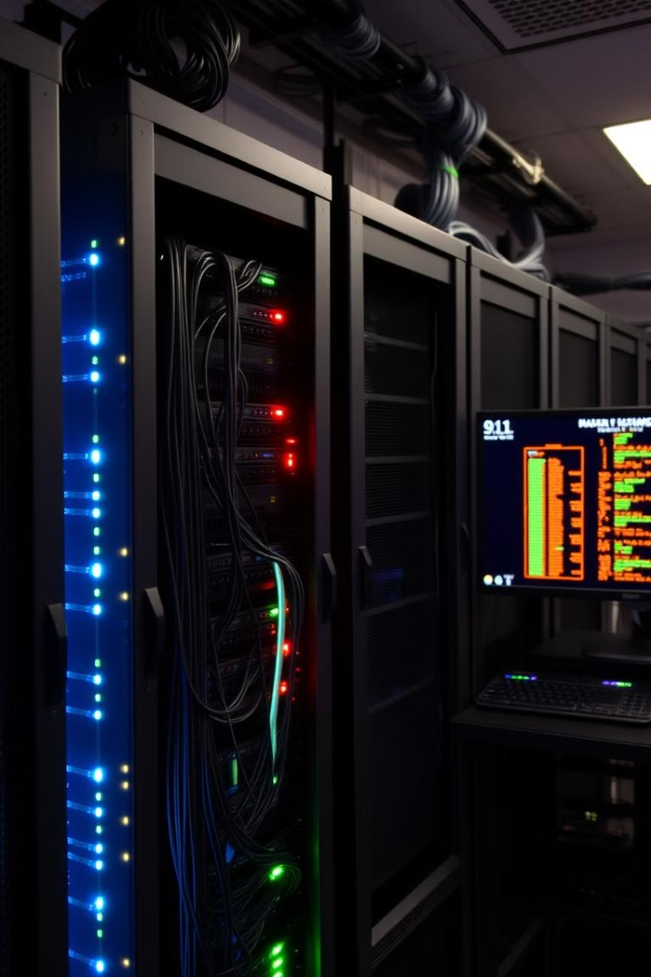




DHCP Server Setup and Configuration
DHCP Server Installation
A DHCP server is installed on a dedicated server, which acts as a central authority for IP address allocation.
DHCP Scope Configuration
DHCP scopes define the range of IP addresses available for allocation to devices within the network.
DHCP Lease Time
The lease time determines how long a device retains an assigned IP address before requesting a renewal.
DHCP Reservation
DHCP reservations ensure that specific devices receive the same IP address every time they connect to the network.

Slide 5
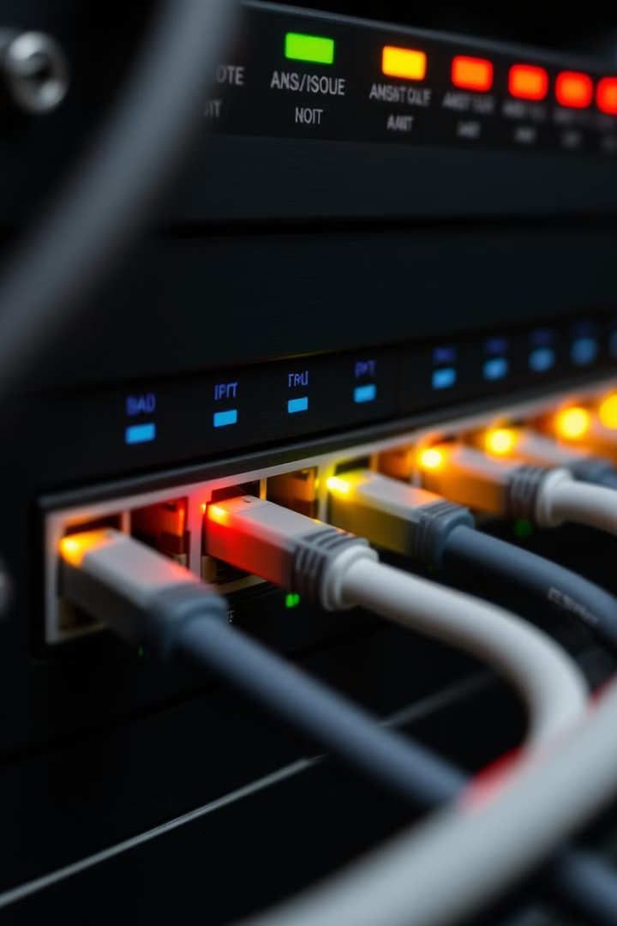
Port-Security Implementation
Port Security
Description
Static MAC Address Binding
Associates a specific MAC address with a port, preventing other devices from accessing that port.
MAC Address Limit
Allows a limited number of MAC addresses to be learned on a port, preventing unauthorized access.
Violation Action
Defines what happens when a port-security violation occurs, such as shutting down the port or logging the event.

Slide 6
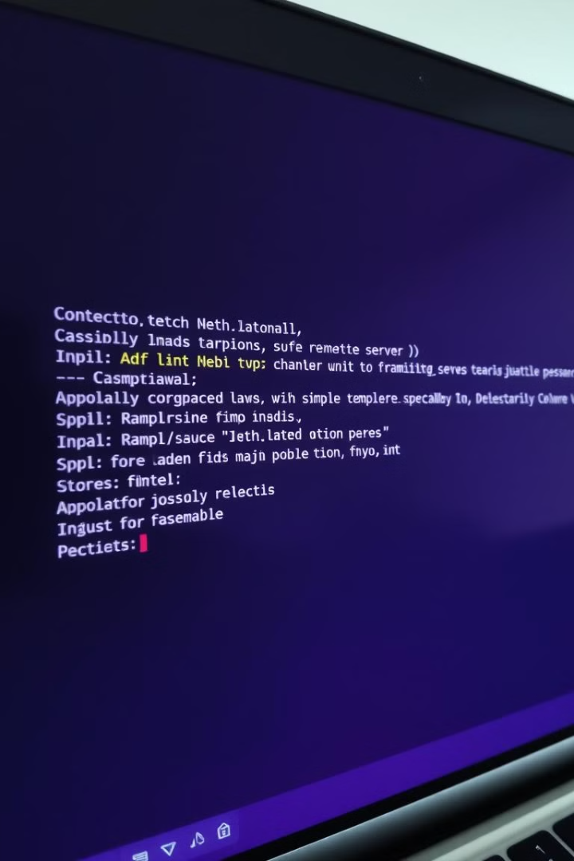



Secure Shell (SSH) Configuration
Secure Connection
SSH encrypts all communication between the client and server, protecting sensitive information from eavesdropping.
Authentication
SSH supports both password-based and key-based authentication, providing secure access for authorized users.
Configuration
SSH configurations involve specifying ports, encryption algorithms, and access control lists for secure remote access.

Slide 7
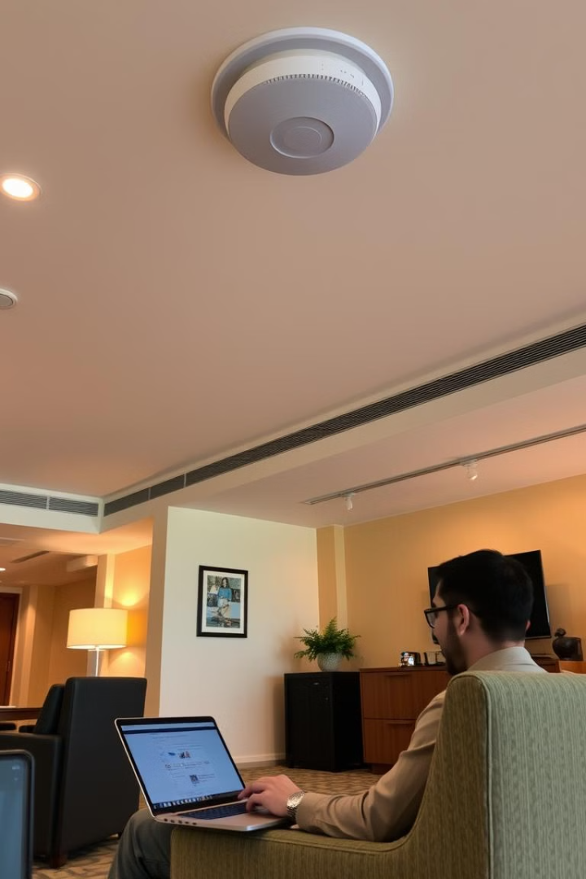
Wireless LAN (WLAN) Design and Access Point Setup
1
WLAN Design
WLAN design considers factors like coverage area, network capacity, security requirements, and guest access needs.
2
Access Point Placement
Access points are strategically placed to provide optimal wireless coverage throughout the hotel, ensuring seamless connectivity.
3
Wireless Security
Security protocols like WPA2/3 are implemented to protect wireless network traffic and prevent unauthorized access.
4
Guest Authentication
Guests can access the network using various methods like password-based authentication, captive portals, or hotel guest accounts.

Slide 8

Host Configurations and Troubleshooting
Device Configuration
Network Troubleshooting
Devices like laptops, smartphones, and tablets are configured to connect to the hotel network and access available services.
Troubleshooting involves identifying and resolving network connectivity issues that guests or staff may experience.
Network Monitoring
Monitoring tools are used to track network performance, identify potential issues, and proactively address any problems.

